Slide 1

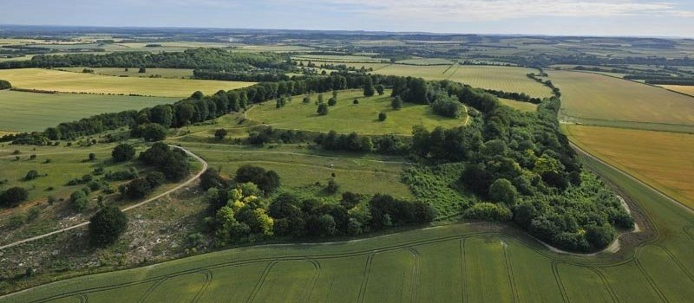
What can this single green hill possibly tell us about life in the Iron Age?

Slide 2
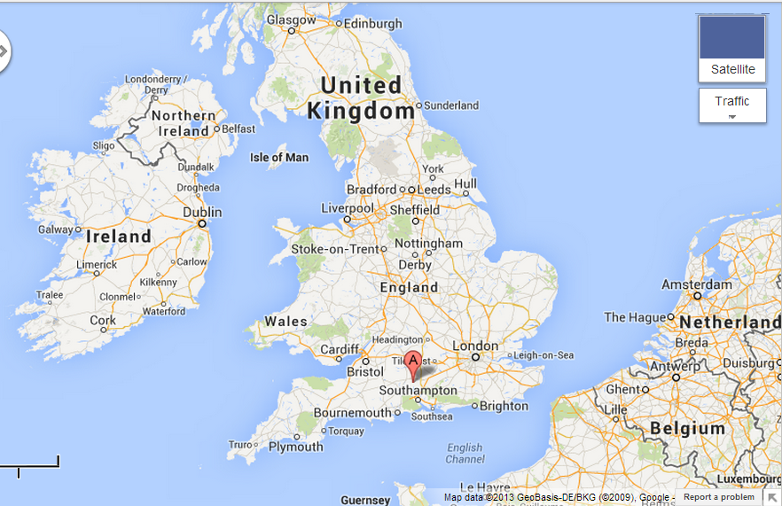
It shows us a place called Danebury in Hampshire
Danebury

Slide 3
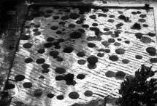
When they cleared away all the grass and soil about 50 years ago, this is what they found.
But what are all those round holes for?
In the Iron Age
2,500 years ago

Slide 4
The excavations showed that within the fort there was evidence of 73 roundhouses, 500 rectangular buildings and thousands of deep storage pits. The circular houses were for people, the store buildings and pits held their most valuable commodity grain. The pits were dug from the chalk. They had a narrow entrance, so the base was wider than the neck of the pit. The pits were filled with grain and then sealed.

Slide 5
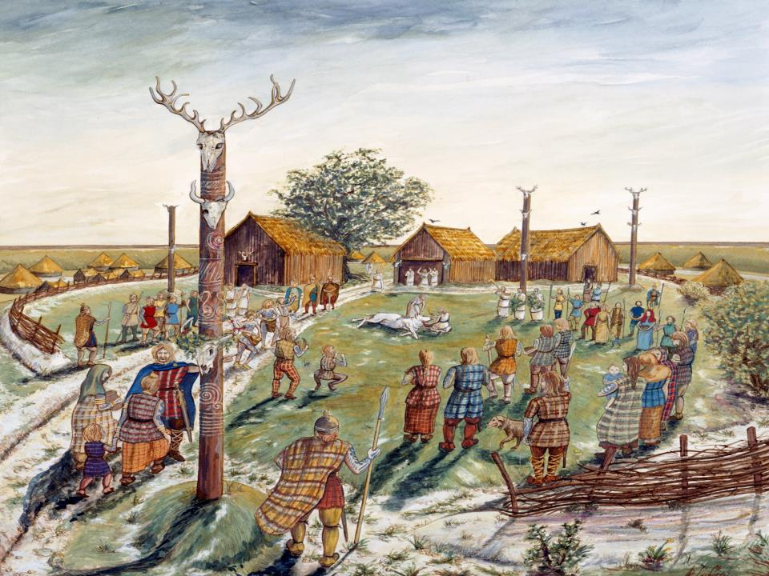
After carrying out lots of archaeological digs and research this is the sort of picture of life at Danebury that experts come up with. But how do they do it?
©Mary Evans Picture Library

Slide 6
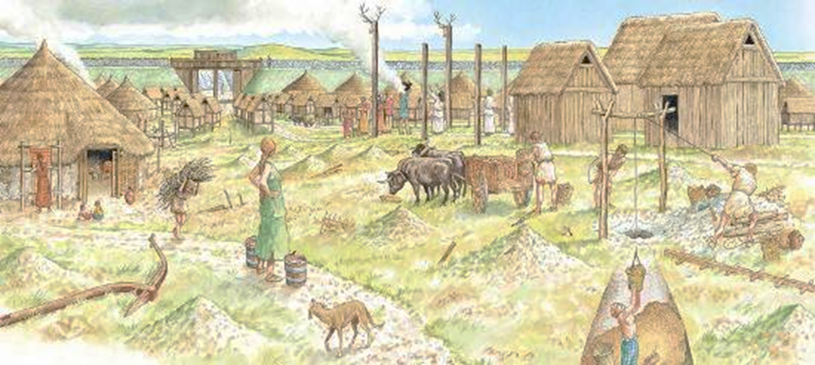

Slide 7
We’re going to have a go at a slightly simpler one. I want you to work in 3s.
Study the picture you have been given . Label in the inside zone all the things that you are sure you recognise.
In the next zone out, label what you think that part of the picture tells us about life in the Iron Age.
On the outer zone, write down all the things that you don’t understand or questions you want answers to.

Slide 8

What I don’t understand
What I can work out
What I can see

Slide 9
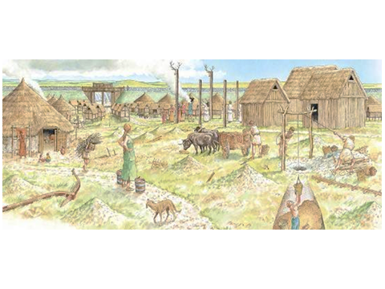
❸
❿
❾
❷
❺
❼
❹
❶
❽
❻

Slide 10
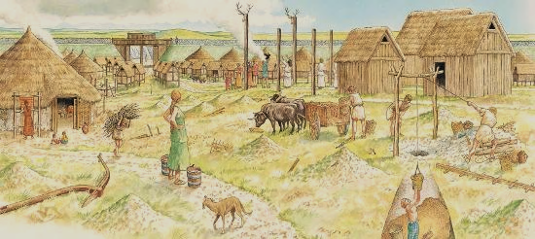
Religious figure of animal
Round house
Barn for storing grain
Gateway to fort
Weaving wool
Cattle for moving heavy loads
Plough or ard for the fields
Kept domestic pets
Fuel for fires
Mining chalk

Slide 11
❸
❿
❾
❷
❺
❼
❹
❶
❽
❻

Slide 12
Yes but where does the evidence come from?
Let’s start with a few objects that were found. Can we match up the objects with the right label?

Slide 13
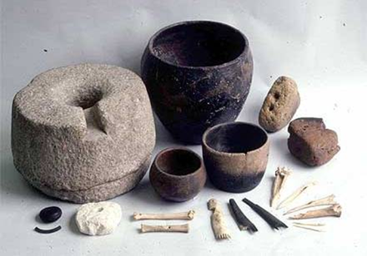
Helping the careless curator

Slide 14
Muddled labels
Beaker
Comb
Cooking pot
Quern stone for grinding grain into flour
Needle
Weight for the weaving loom

Slide 15
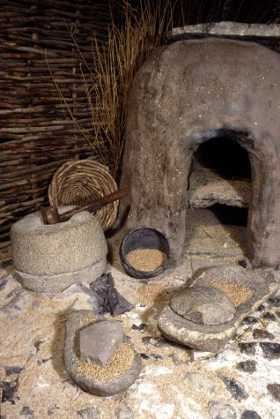
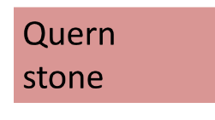

Can you do the same for what it might look like inside an Iron Age hut?
Grain

Slide 16
We are now going to look at statements made about life in Danebury Hill fort and see where the information came from?

Slide 17
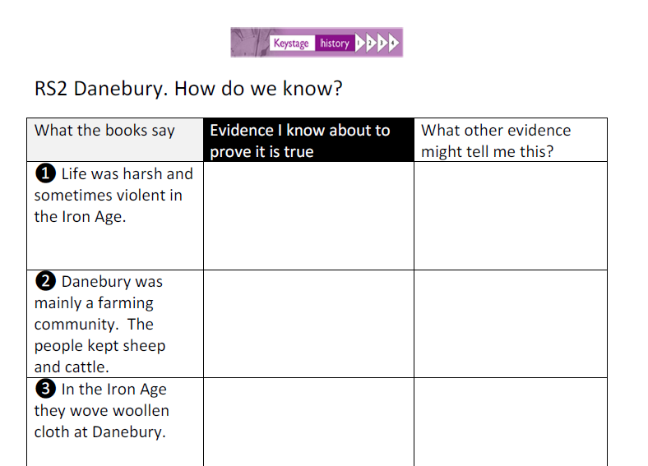

Slide 18
We’ll start by listening to a short video clip
http://www.youtube.com/watch?feature=player_embedded&v=uFM7u1B323E
showing violence done to skulls.
What does the evidence on the film tell us about life in the Iron Age?

Slide 19
You might also like to know that..
As Danebury had few natural resources it relied on trade with other areas to obtain iron, tin, copper, salt, …and stone. It is likely that woollen products and grain were traded in exchange for these.

Slide 20
Now the fun bit
Design an App for a Museum of the Iron Age

Slide 21


Design an App for an iPad
Give each important features a number then rerecord what the voice says when that number is pressed .

Slide 22
Credits
We are grateful to Hampshire County Council for permission to use the images displayed on their website
http://www3.hants.gov.uk/museum-of-the-ironage.htm

